Slide 1
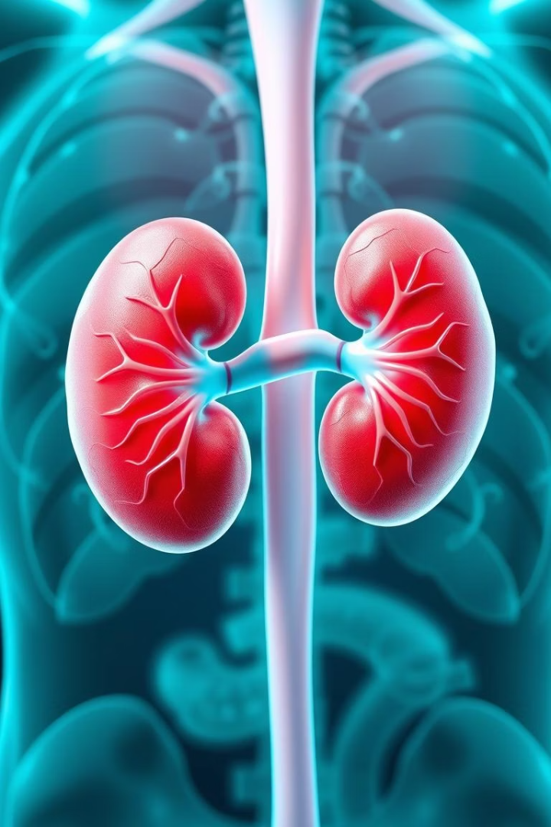

Chronic Kidney Disease Prediction Using Machine Learning
BY:
Prayansh Sukhija [E23CSEU0548]
Rohan Kumar [E23CSEU2437]
Bennett University

Slide 2


Introduction: Understanding Chronic Kidney Disease
Chronic Kidney Disease (CKD) involves progressive kidney function loss.
Affects ~143 million Indian adults (15% of adult population, if similar to US — CDC 2023)
Early prediction enables timely intervention, slowing disease progression.
Early Detection
Cost Reduction
Accurate Model
Allows timely intervention and slows disease progression.
Reduces healthcare costs
Goal: To develop an accurate ML model for early CKD prediction.

Slide 3

Project Overview: AI-Driven Prediction Model
Utilized dataset from Kaggle for CKD Prediction
Model architecture: XGBoost with Random Forest Classifier
Input variables included vital signs, lab values, and medical history.
Validation used rigorous cross-validation ensuring robustness.

Slide 4

Dataset Overview: Features and Preprocessing
The dataset originates from Kaggle
It includes 400 instances and 24 features plus class labels.
Key features include age, blood pressure, and serum creatinine.
Missing Values
Encoding
Feature Scaling
Handled via imputation or removal.
Categorical features encoded using One-Hot Encoding and Label Encoding
Standardization or Normalization applied, e.g., StandardScaler.

Slide 5

Economic Impact: Reducing Healthcare Burden
Early detection slows disease progression
Decreases long-term treatment costs
Reduces hospital visits and improves patient productivity
Improves workforce participation and reduces
disability rates

Slide 6




Methodology: ML Models, Training, and Evaluation
We employed Random Forest, and XGBoost.
Data was split: 80% for training and 20% for testing (stratified).
.
Models
1
Training
Selection of ML models
2
Data split and cross-validation
4
Evaluation
3
Tuning
Performance metrics measured
Hyperparameter optimization

Slide 7
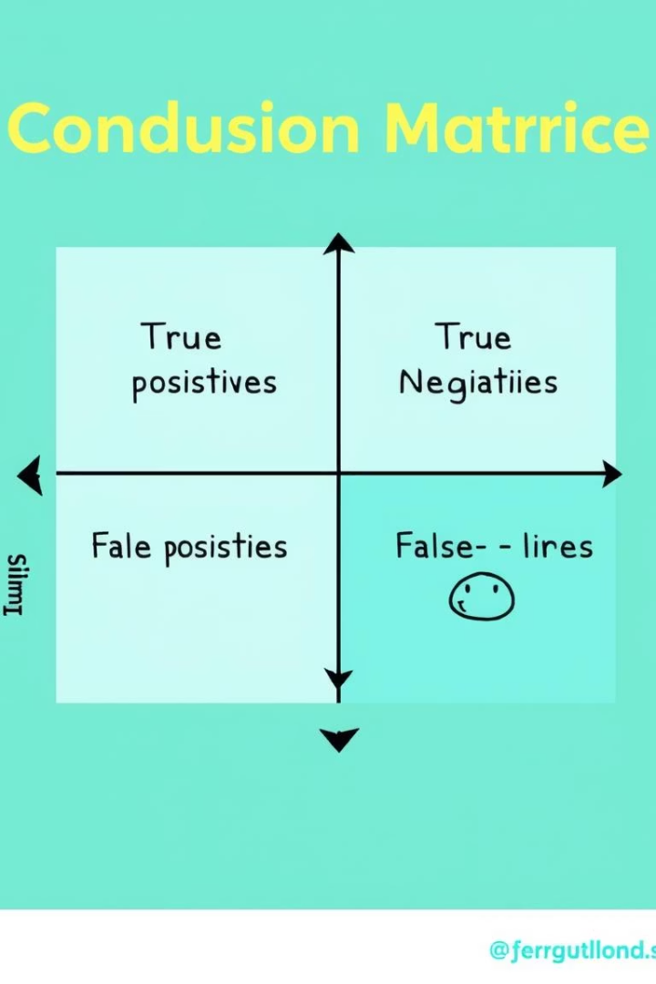


Results: Performance and Key Findings
XGBoost outperformed other models in accuracy and AUC-ROC.
Important features: Serum Creatinine, Hemoglobin, and Albumin levels.
The models were highly predictive of CKD.
Model
Accuracy
Random Forest
XGBOOST
99%
98%

Slide 8
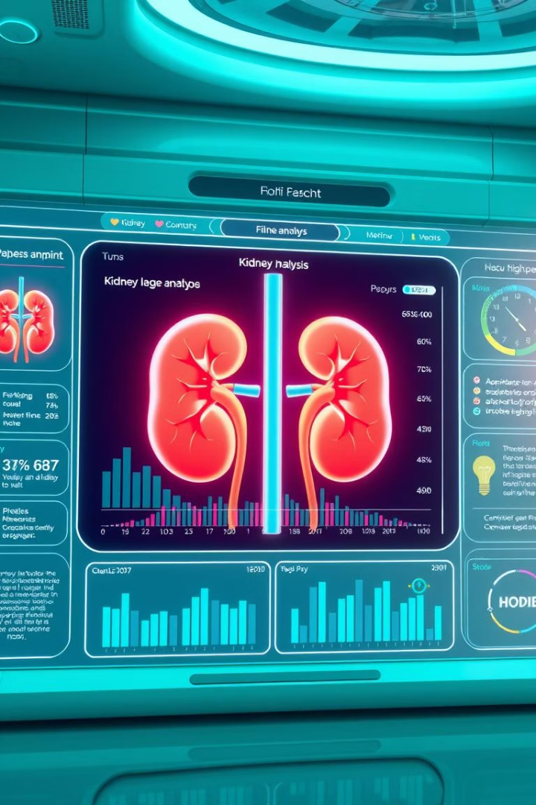



Conclusion: Summary, Improvements, and Applications
Developed ML models for CKD prediction with high accuracy.
Potential improvements: Incorporate more clinical data.
Applications: Early screening, decision support, treatment planning.
Summary
Accurate CKD prediction
Improvements
Incorporate more data
Applications
Early screening, decision support

